Slide 1
Pilot data (2021.Jul 4 – Jul 5)

Slide 2
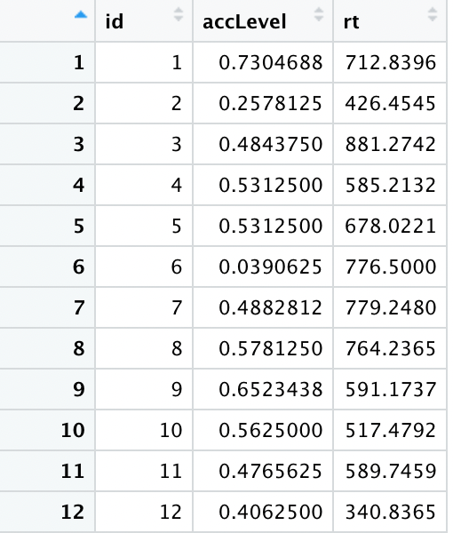
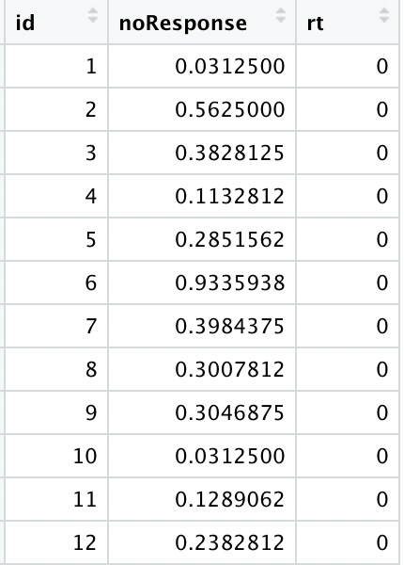
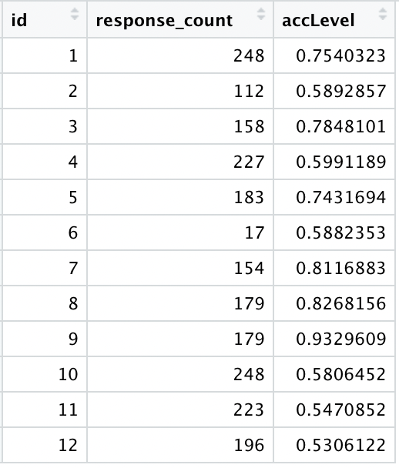
Size-judgment-task: Is the study treated seriously?
General accuracy: a horror story
People just did not respond: need more motivation?
After excluding no response trials.

Slide 3
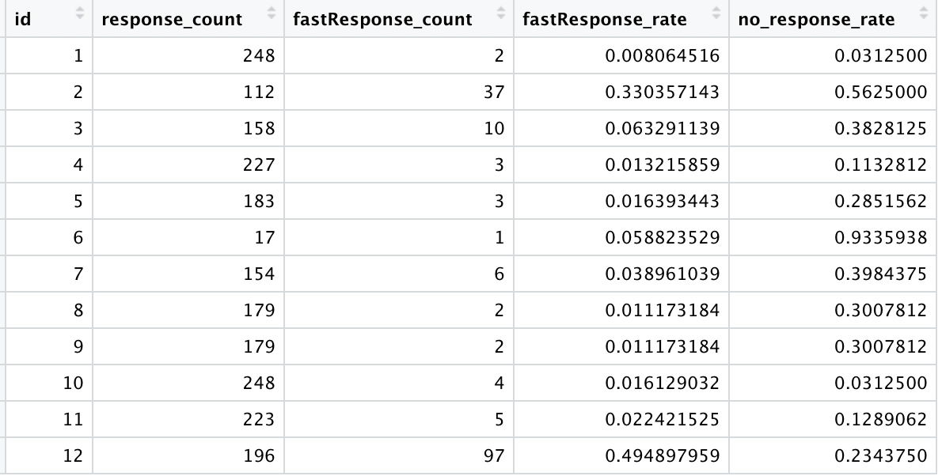
Clicker & random pressing? Too fast response
Id = 1, 4, 5,8,9,10,11
No_response excluded

Slide 4
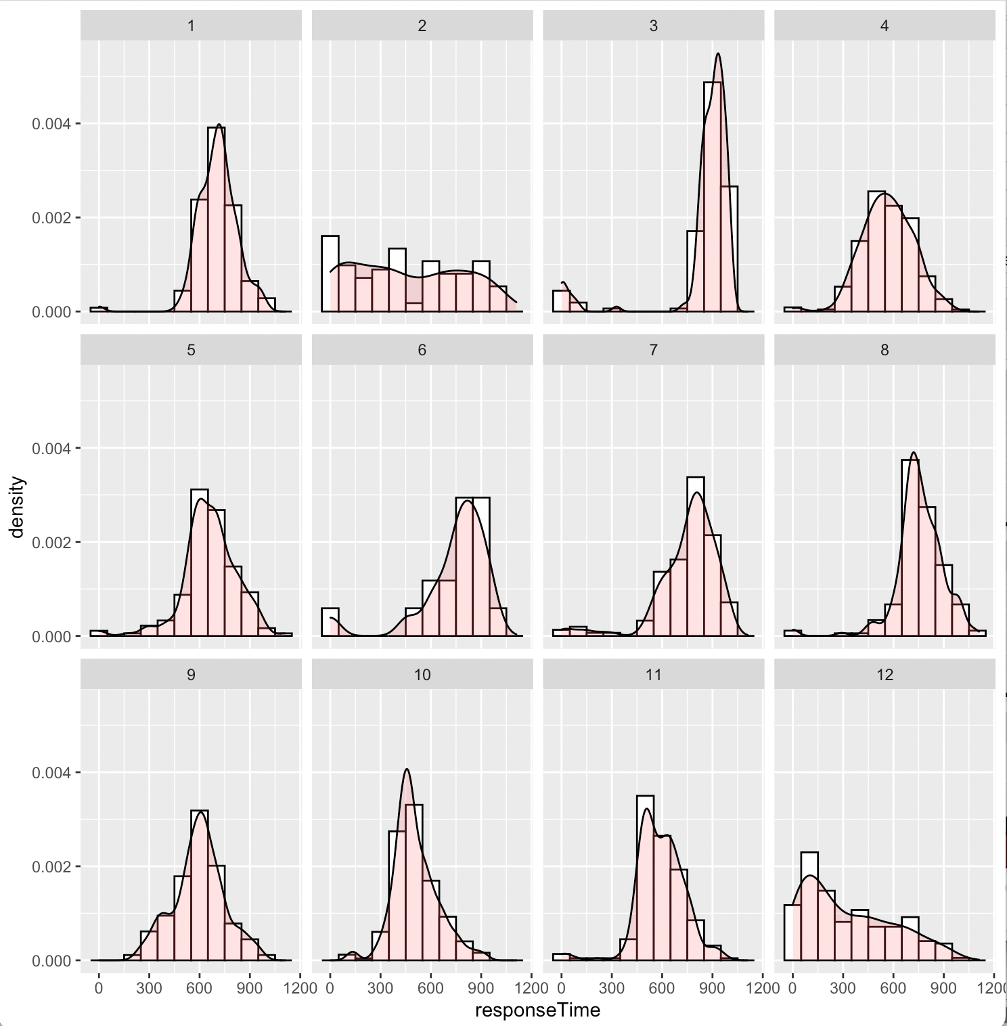
Id = 1, 4, 5,8,9,10,11

Slide 5
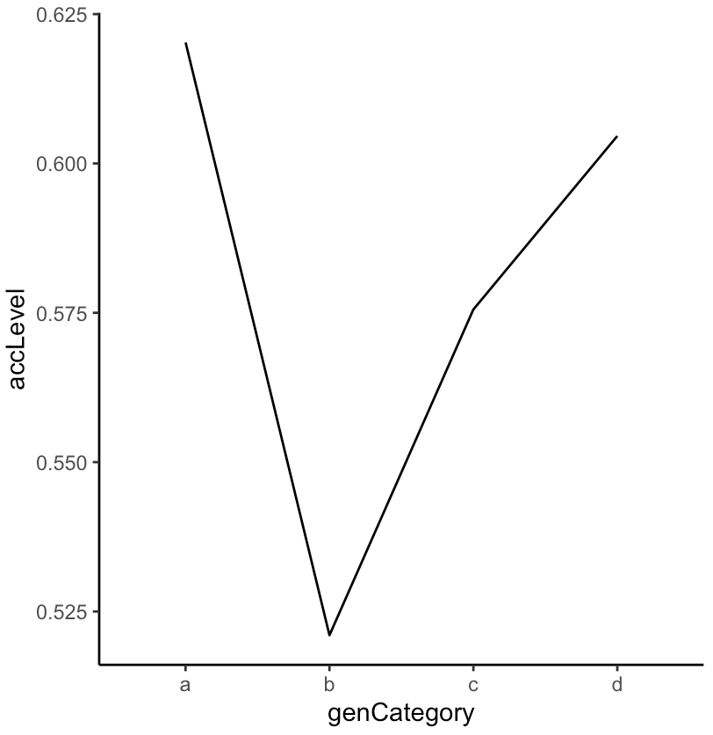
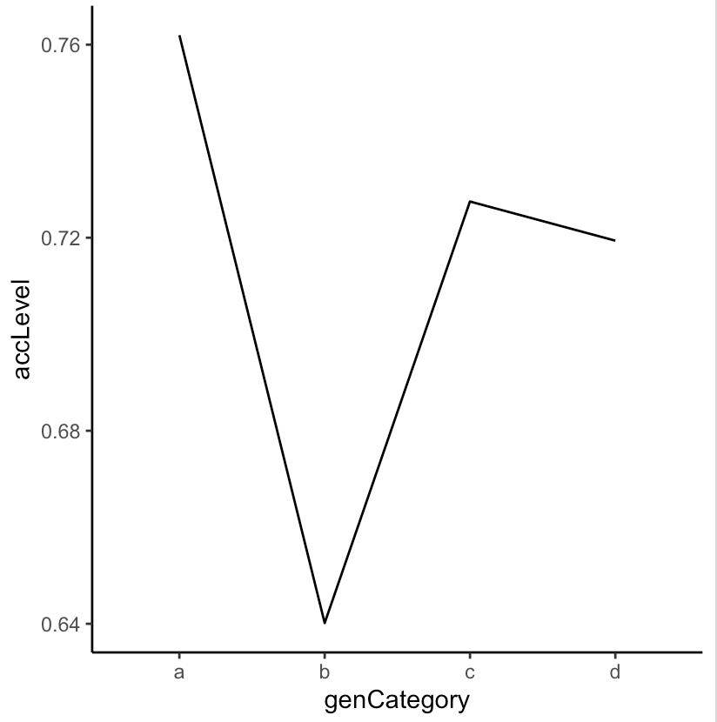
A: animal; B: Tools; C: Kitchen equipment; D: Musical instrument
No response trials excluded
All trials included

Slide 6
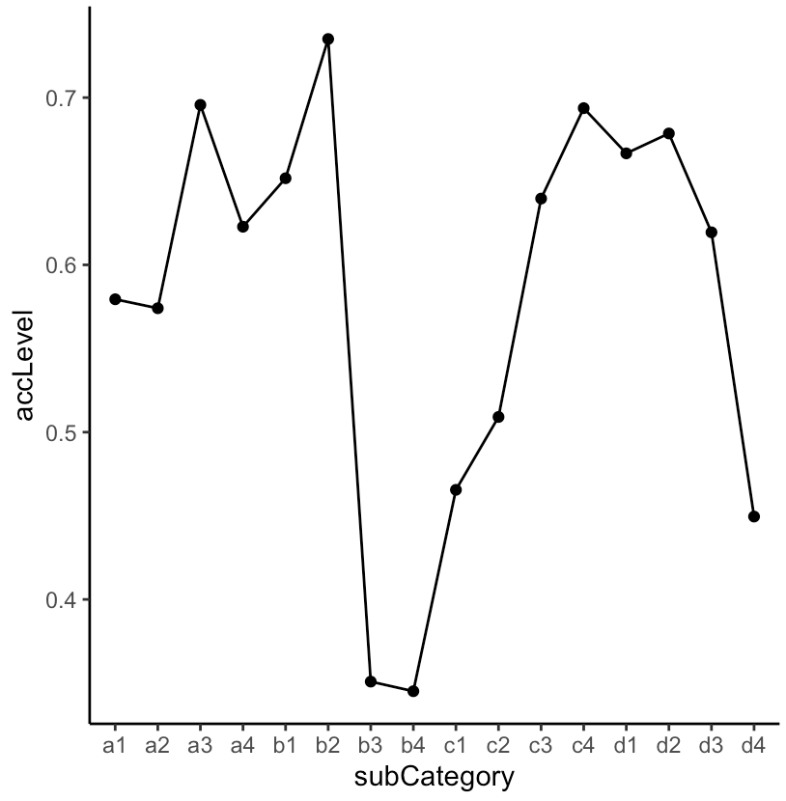
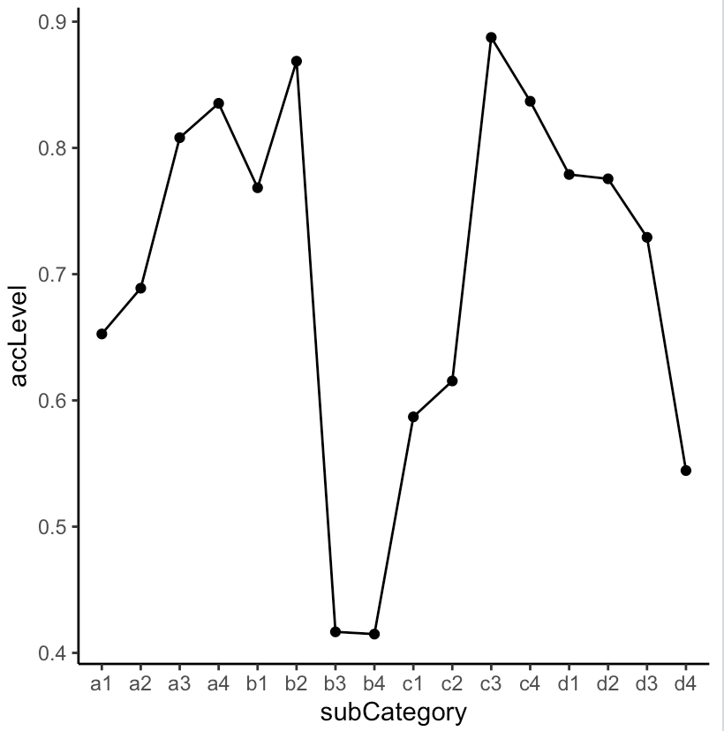
A1-hamster A2-squirrel A3-deer A4-bear
B1-hammer B2-screwdriver B3-hoe B4-rake
C1-toaster C2-kettle C3-Oven C4-Dishwasher
D1-harmonica D2-flute D3-guitar D4-harp
No response trials excluded
All trials included

Slide 7
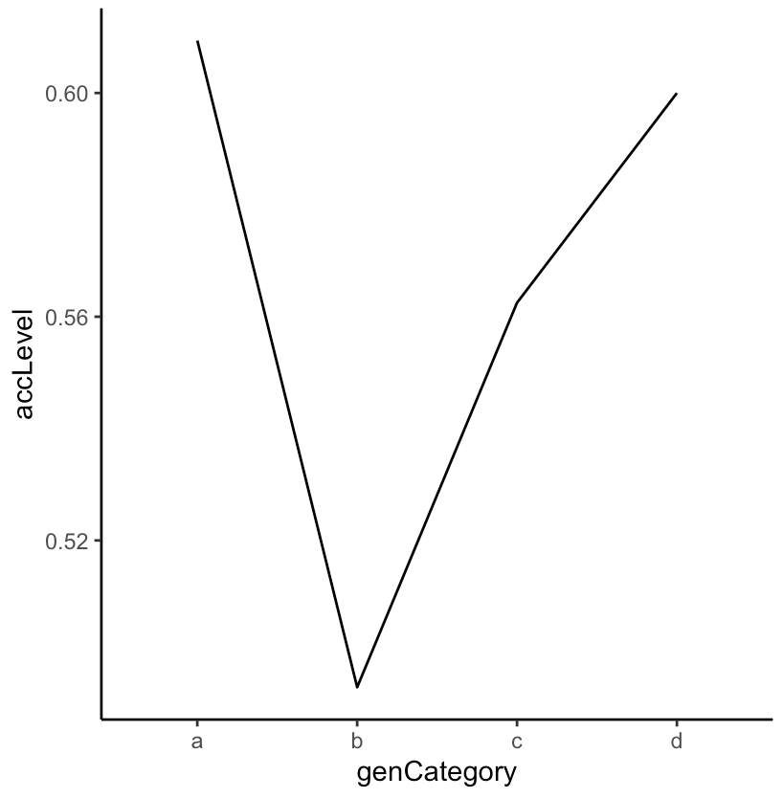
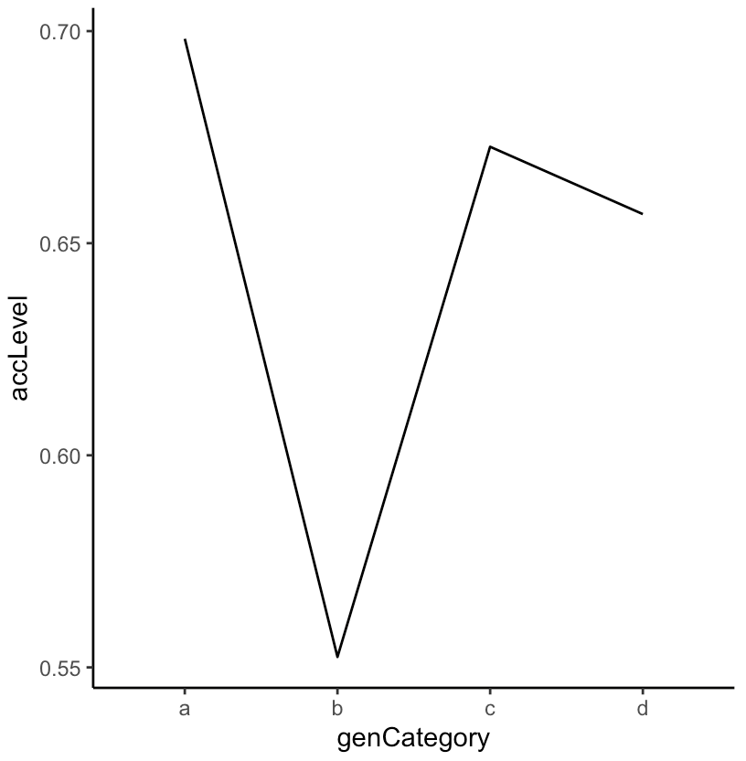
How about only participants id = 1,4,5,10,11
A: animal; B: Tools; C: Kitchen equipment; D: Musical instrument

Slide 8
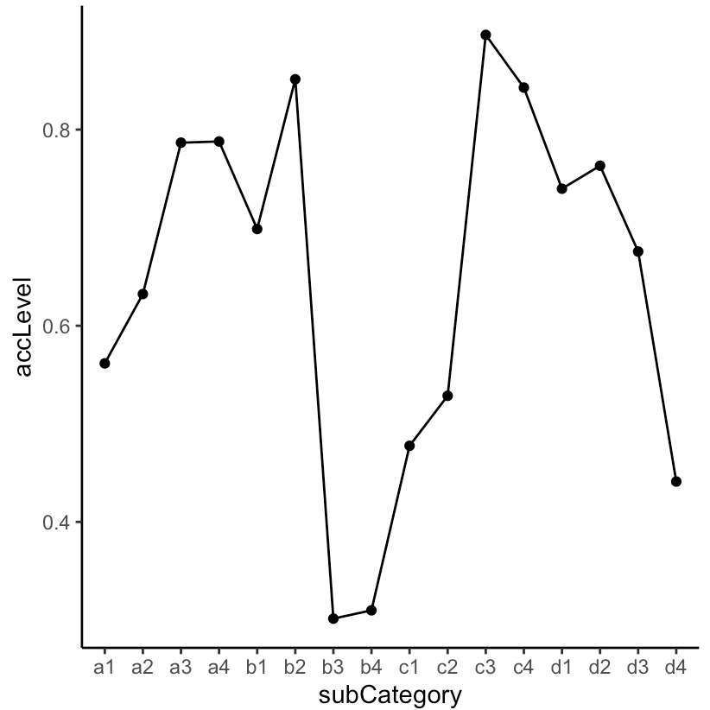
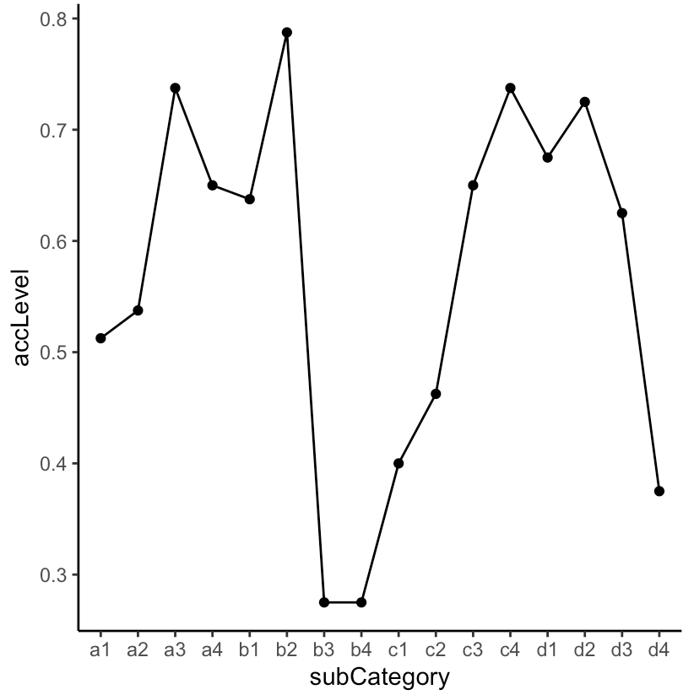
A1-hamster A2-squirrel A3-deer A4-bear
B1-hammer B2-screwdriver B3-hoe B4-rake
C1-toaster C2-kettle C3-Oven C4-Dishwasher
D1-harmonica D2-flute D3-guitar D4-harp
No response trials excluded
All trials included

Slide 9
What if my participants are not out of mind?
Reference photo looks too big a suitcase?
Solution: smaller reference photo?
People still believe that animals should not be put into the suitcase?
Solution: make the instruction even more direct like ‘the task is not about what is allowed or should be put into the suitcase. It’s only about the size judgment. For example, fireworks are not allowed to be put into the carry-on bags but it’s smaller than the suitcase and thus could fit into the carry-on suitcase.’
Previously tools are pretty good. But this time, they are the worst. Is it because they look small?
Solution: shrink all photos?
Kettles do pretty good last time. Is it because they look giant?
Solution: the same as the above
How come bears more difficult than dear to judge the size?
What if some pictures like harmonica, toaster, harp could not be recognized?
What if people do not know the size of a harp?

Slide 10
How to make participants take this experiment more seriously?
Worker qualification: 100 + accepted hits
Monetary motivation: performance is related to monetary compensation
Instruction #1: warning the possibility of being rejected because we could detect scammer or random response
Instruction #2: warning the possibility of being rejected because of not passing the attention check test
SONA instead of mTurk?

Slide 11
Next step
Revise instructions
Move the script out of Pavlovia
Add attention check trials in the memory test session
Plan: if see an image of a scene, press ‘R’
Add key press lock during the trial to avoid holding the keys or machine-press or random press

